Slide 1
Marketing Campaign Analysis Report
By SRAVAN KUMAR

Slide 2
TOPIC
Overview
Introduction
Key Metrics
Most Profitable
Category/Keyword
Impact of Geography
ROI Analysis
Conclusion
Contact Information

Slide 3

Overview
Project Overview: This presentation provides an in-depth analysis of our recent marketing campaigns to gain insights into their performance and effectiveness.
Key Objectives:
Optimize Marketing Spend: Identify opportunities to improve the return on investment (ROI) and maximize the impact of our marketing budget.
Discover Profitable Channels: Determine which marketing channels are delivering the highest returns and prioritize their utilization.
Evaluate Keyword/Category Performance: Analyze the performance of different keywords/categories to focus on the most profitable ones.

Slide 4
KeyMetrics
Count of people marked as potential customers by sales.
Assists in measuring the quality of potential leads.
Cost($)
Total ad spend for each campaign date.
Helps us understand the overall investment in marketing activities.
Prospects
Payments($)
Total revenue generated from the campaigns.
Measures the returns received from our marketing efforts.
Return Percentage
Calculated as Payment($)/Cost($) * 100.
Represents the return on investment (ROI) for each campaign.
A crucial metric to assess the profitability of our marketing efforts.

Slide 5
Most Profitable
One of the crucial objectives of our marketing campaign analysis is to identify the most profitable channel that delivers the highest return on investment (ROI). By determining the channel with the best performance, we can optimize our marketing efforts and allocate resources more effectively. Let's delve into the analysis to uncover the most profitable channel:
Return Percentage by Channel:
Compare the return percentage (ROI) for each marketing channel, such as Google Ads and the listing site.Visualize the performance of each channel using bar charts or line graphs.
Identification of Most Profitable Channel:
Identify the channel with the highest average return percentage.Explore factors contributing to its success and effectiveness.
Optimization Opportunities:
Discuss strategies to further enhance the ROI of the most profitable channel.

Slide 6
Understanding the market

Slide 7
Category/Keywords
In addition to identifying the most profitable marketing channel, it is equally important to discover the most profitable category or keyword within our campaigns. By pinpointing the keywords or categories that drive the highest returns, we can optimize our ad targeting and content strategies for maximum impact. Let's explore the analysis to uncover the most profitable category/keyword:
Return Percentage by Category/Keyword:
Compare the return percentage (ROI) for different keywords or categories used in our campaigns.Present the performance of each keyword/category using visualizations like bar charts or line graphs.
Identification of Most Profitable Category/Keyword:
Reveal the specific keyword or category that generates the highest average return percentage.Discuss the significance of this finding in our marketing strategy.
Strategies for Targeting Profitable Categories/Keywords:
Offer recommendations on how to leverage the most profitable keywords/categories.Suggest ad optimization techniques and audience targeting strategies.
QCK TIP
Try right clicking on a photo and using "Replace Image" to show your own photo.

Slide 8
Impact of Geography
Understanding how geography influences the performance of our marketing campaigns is essential for optimizing our marketing strategies on a regional level. By analyzing the impact of different geographical locations, we can identify areas of opportunity and focus our efforts where they are most likely to yield the best results. Let's explore the geographical impact on our marketing campaigns:
Geographic Distribution of Key Metrics:
Present time series plots of key metrics (e.g., 'Cost($)', 'Payment($)', 'Clicks', 'Impressions', 'Leads', 'Prospects') segmented by country or region. Visualize the performance of each metric across different geographical locations.
Regional Contribution to Metrics:
Analyze how different countries or regions contribute to the key metrics.
Notable Observations and Regional Insights:
Share any significant findings or insights related to specific regions or countries.

Slide 9
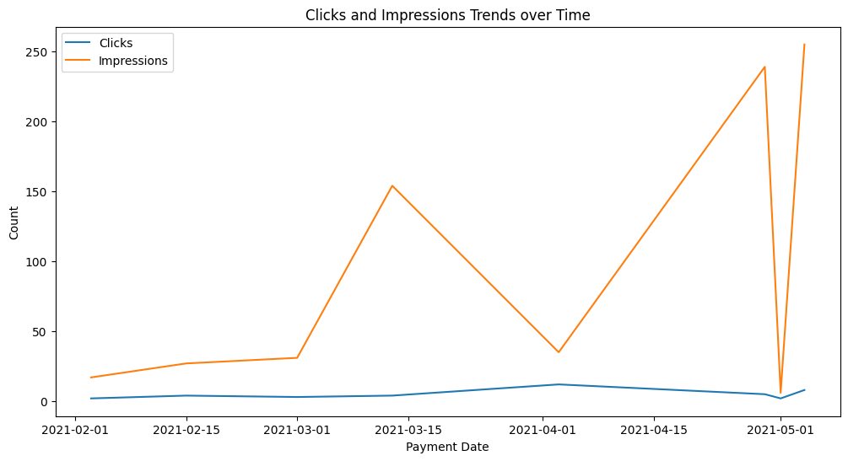

Slide 10
The Return on Investment (ROI) analysis is a crucial component of our marketing campaign assessment. It provides a clear understanding of the overall profitability of our marketing efforts and the effectiveness of our ad spend. Let's delve into the ROI analysis:
Time Series Plot of 'Returns_Percentage:
Display the time series plot of the 'Returns_Percentage' metric over time.Visualize the fluctuations in ROI and any recurring patterns or trends.
Assessment of Campaign Profitability:
Evaluate the overall profitability of our marketing campaigns based on the 'Returns_Percentage.how our marketing initiatives have performed in generating returns.
Return on Investment(ROI)
.

Slide 11
Conclusion
In conclusion, the Marketing Campaign Analysis Report has provided a comprehensive evaluation of our recent marketing initiatives, yielding valuable insights that will drive data-driven decision-making and optimize future marketing strategies. Here are the key findings and takeaways from the analysis:
Our marketing campaigns have seen fluctuations in key metrics, indicating the need for continuous monitoring and optimization.
The 'Cost($)' and 'Payment($)' metrics have been analyzed, providing a clear understanding of our investment and returns.
Clicks and impressions have shown trends aligned with our promotional activities, indicating effective reach and engagement.
Lead generation and prospect counts reveal promising opportunities for customer acquisition and conversion.
The 'Returns_Percentage' metric has been crucial in assessing the profitability of our campaigns, guiding resource allocation.

Slide 12
Contact Information
Sravan Kumar Dabbi
Bachelor of Technology(B.Tech) (CSE)
sravankumardabbi001@gmail.com
+91 9390529288
For more information click the link here
https://drive.google.com/drive/folders/1Bs4SMVCfbOgMf7NJUR-hP-g--N2_MOLv?usp=drive_link

Slide 13
Info
https://github.com/Sravankumardabbi001/Omnify_Assignment
+91 9390529288
Linkedin
GitHUB
Phone
https://www.linkedin.com/in/dabbisravankumar/

Slide 14
Thank you.

